Slide 1


Comprehensive Introduction to Data, Databases, ETL, and Informatica Tools
Welcome to this comprehensive introduction to data, databases, ETL, and Informatica tools, where we'll delve into the fundamentals of data integration, explore the power of Informatica PowerCenter, and gain hands-on experience with IICS.
by Gopi krishna

Slide 2
Understanding the Fundamentals of Data
Data Types
Database Concepts
Explore various data types, such as numerical, textual, and date-time, understanding their characteristics and usage in different contexts.
Dive into the key concepts of databases, including relational databases, SQL, data models, and data integrity, laying the foundation for data integration.

Slide 3
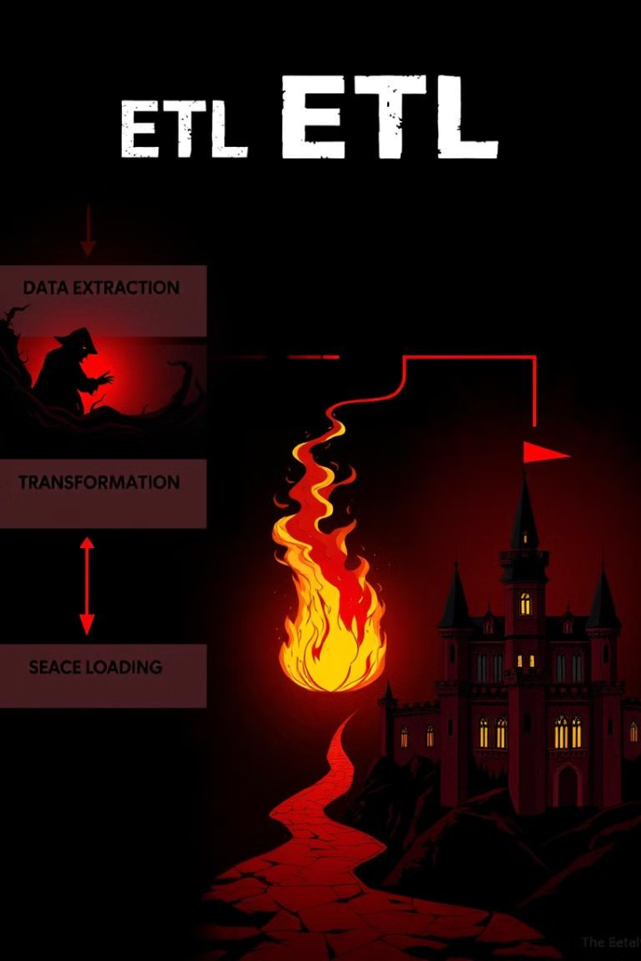
The Essence of Extract, Transform, and Load (ETL)
1
Extract
2
Transform
Learn how to extract data from various sources, including databases, files, and APIs, understanding the process of data retrieval and formatting.
Explore data transformations, such as cleansing, aggregation, and data type conversions, essential for preparing data for loading into the target system.
3
Load
Understand the process of loading transformed data into the target system, whether it's a database, data warehouse, or other destination.

Slide 4
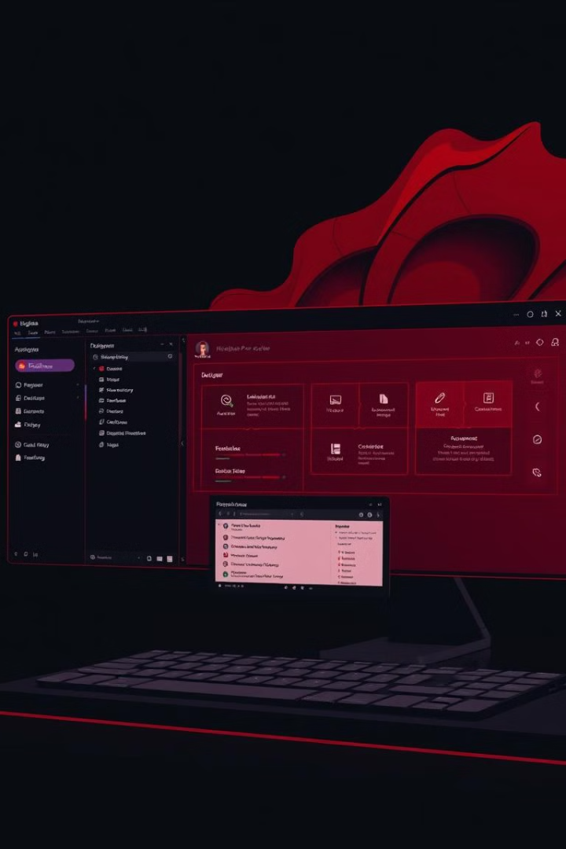
Introducing the Informatica PowerCenter Platform
Designer
Workflow Manager
Learn about the PowerCenter Designer, the core tool for designing and developing ETL workflows, allowing you to create mappings, sessions, and workflows.
Understand how to manage and monitor ETL workflows using the Workflow Manager, ensuring data integrity and efficient execution of data integration tasks.
Repository Manager
Explore the Repository Manager, responsible for storing metadata about data sources, transformations, and target systems, providing a centralized repository for managing data integration assets.

Slide 5
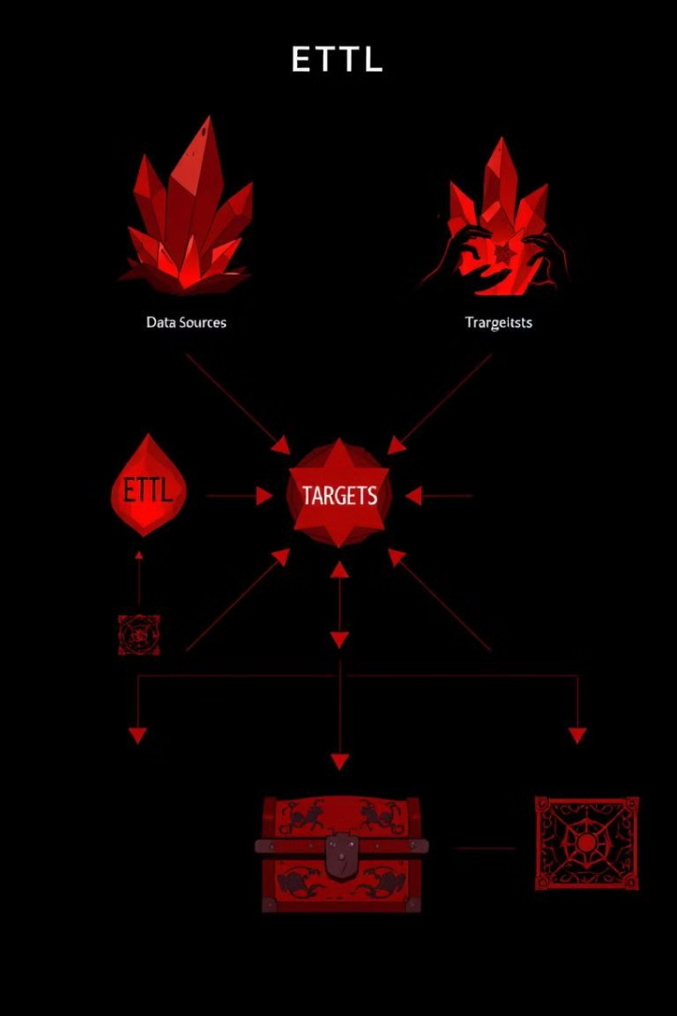



Designing and Developing Basic ETL Workflows
Data Sources
Connect to various data sources, including databases, flat files, and APIs, using PowerCenter connectors to retrieve data for integration.
Transformations
Apply transformations to data, such as cleansing, sorting, aggregating, and data type conversions, to prepare data for the target system.
Targets
Load the transformed data into target systems, including databases, data warehouses, and other destinations, using PowerCenter's loading capabilities.

Slide 6
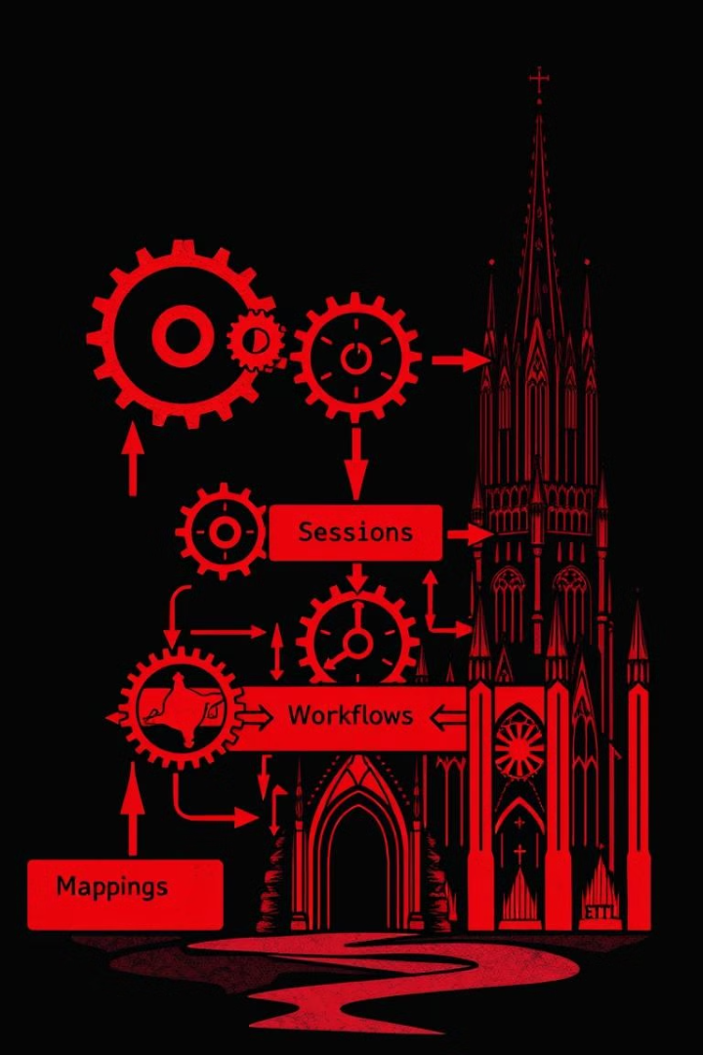
Understanding Mappings, Sessions, and Workflows
1
Mappings
Mappings define the transformation logic, mapping data sources to target systems, specifying data flows and transformations.
2
Sessions
Sessions encapsulate the execution details of a mapping, specifying the data sources, targets, and scheduling of the ETL process.
3
Workflows
Workflows orchestrate and manage the execution of multiple sessions, providing a flexible and controlled environment for complex data integration tasks.

Slide 7




Exploring Advanced Informatica Features
Mapplet
Mapplets are reusable components for complex transformations, simplifying workflow development and promoting code reusability.
Parameter
Parameters allow for dynamic input values in mappings and sessions, providing flexibility and control over ETL processes.
Lookup
Lookups enable efficient data retrieval from external sources, enhancing data quality and accuracy in ETL workflows.

Slide 8



Informatica Intelligent Cloud Services (IICS)
Data Ingestion
1
Learn about various data ingestion options, such as cloud connectors, data connectors, and file-based ingestion, for seamless data transfer to the cloud.
Data Transformation
2
Explore cloud-based transformations, including data cleansing, aggregation, and data enrichment, leveraging powerful tools in the IICS environment.
Data Quality
3
Understand the role of data quality in the cloud, including data profiling, data validation, and data cleansing, ensuring accurate and reliable data for analysis and decision-making.

Slide 9
On-Premise vs. Cloud-Based Informatica
Deployment
1
On-premises deployment requires physical infrastructure, while IICS is hosted in the cloud, offering greater flexibility and scalability.
Scalability
2
IICS provides scalability on demand, dynamically adjusting resources based on workload needs, while on-premise solutions require upfront investment in hardware.
Cost
3
IICS follows a subscription-based model, offering pay-as-you-go pricing, while on-premise solutions require significant upfront investments in infrastructure and software.

Slide 10
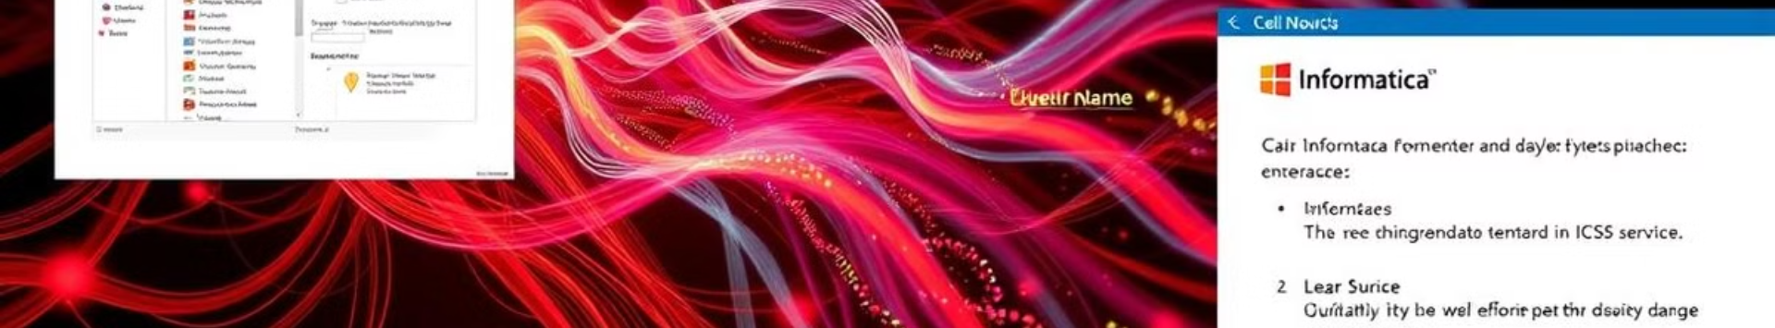
Hands-On Experience and Demos
1
2
PowerCenter
IICS
Hands-on exercises and demos with PowerCenter, guiding participants through practical scenarios of designing and executing ETL workflows.
Interactive sessions and demonstrations with IICS, exploring cloud-based data integration capabilities, including data ingestion, transformation, and data quality.

